Slide 1
SIT216: USER CENTRED DESIGN INTRODUCTION & TOPICS
1

Slide 2

Introduction
Teaching Staff
Dr Hasan Ferdous Lecturer, Deakin University, Australia hasan.ferdous@deakin.edu.au
Co-teachers – SouthWest University,
ChinaDr. Xiangwei Lai (lxw@swu.edu.cn)
Dr. Fuyuan Xiao (xiaofuyuan@yeah.net)

Slide 3
Timeline and Activities
Timeline:
We will have 4 lectures and workshops in the first week, conducted by the co-teachers at SWU.
Then we will have 24 lectures and workshops over 2 weeks as per the schedule below:
2:30 PM —4:50 PM，NOV. 9 （Monday）(3 lectures)
2:30 PM —4:50PM，NOV. 11 （Wednesday）
9:40 AM— 12:10 AM, NOV. 12 (Thursday)
9:40 AM— 12:10 AM, NOV. 13 (Friday)
2:30 PM —4:50 PM，NOV. 16 （Monday）
2:30 PM —4:50PM，NOV. 18 （Wednesday）
9:40 AM— 12:10 AM, NOV. 19 (Thursday)
9:40 AM— 12:10 AM, NOV. 20 (Friday)
There will be 26 more lectures and workshops, conducted by the co-teachers at SWU.
Activities:
Some listening, some thinking and most importantly, some activities and discussions.
Feel free to contact me (Hasan) online if needed after the 2-week period in November (or for help)
All slides, activities and other resources used will be available to you.

Slide 4
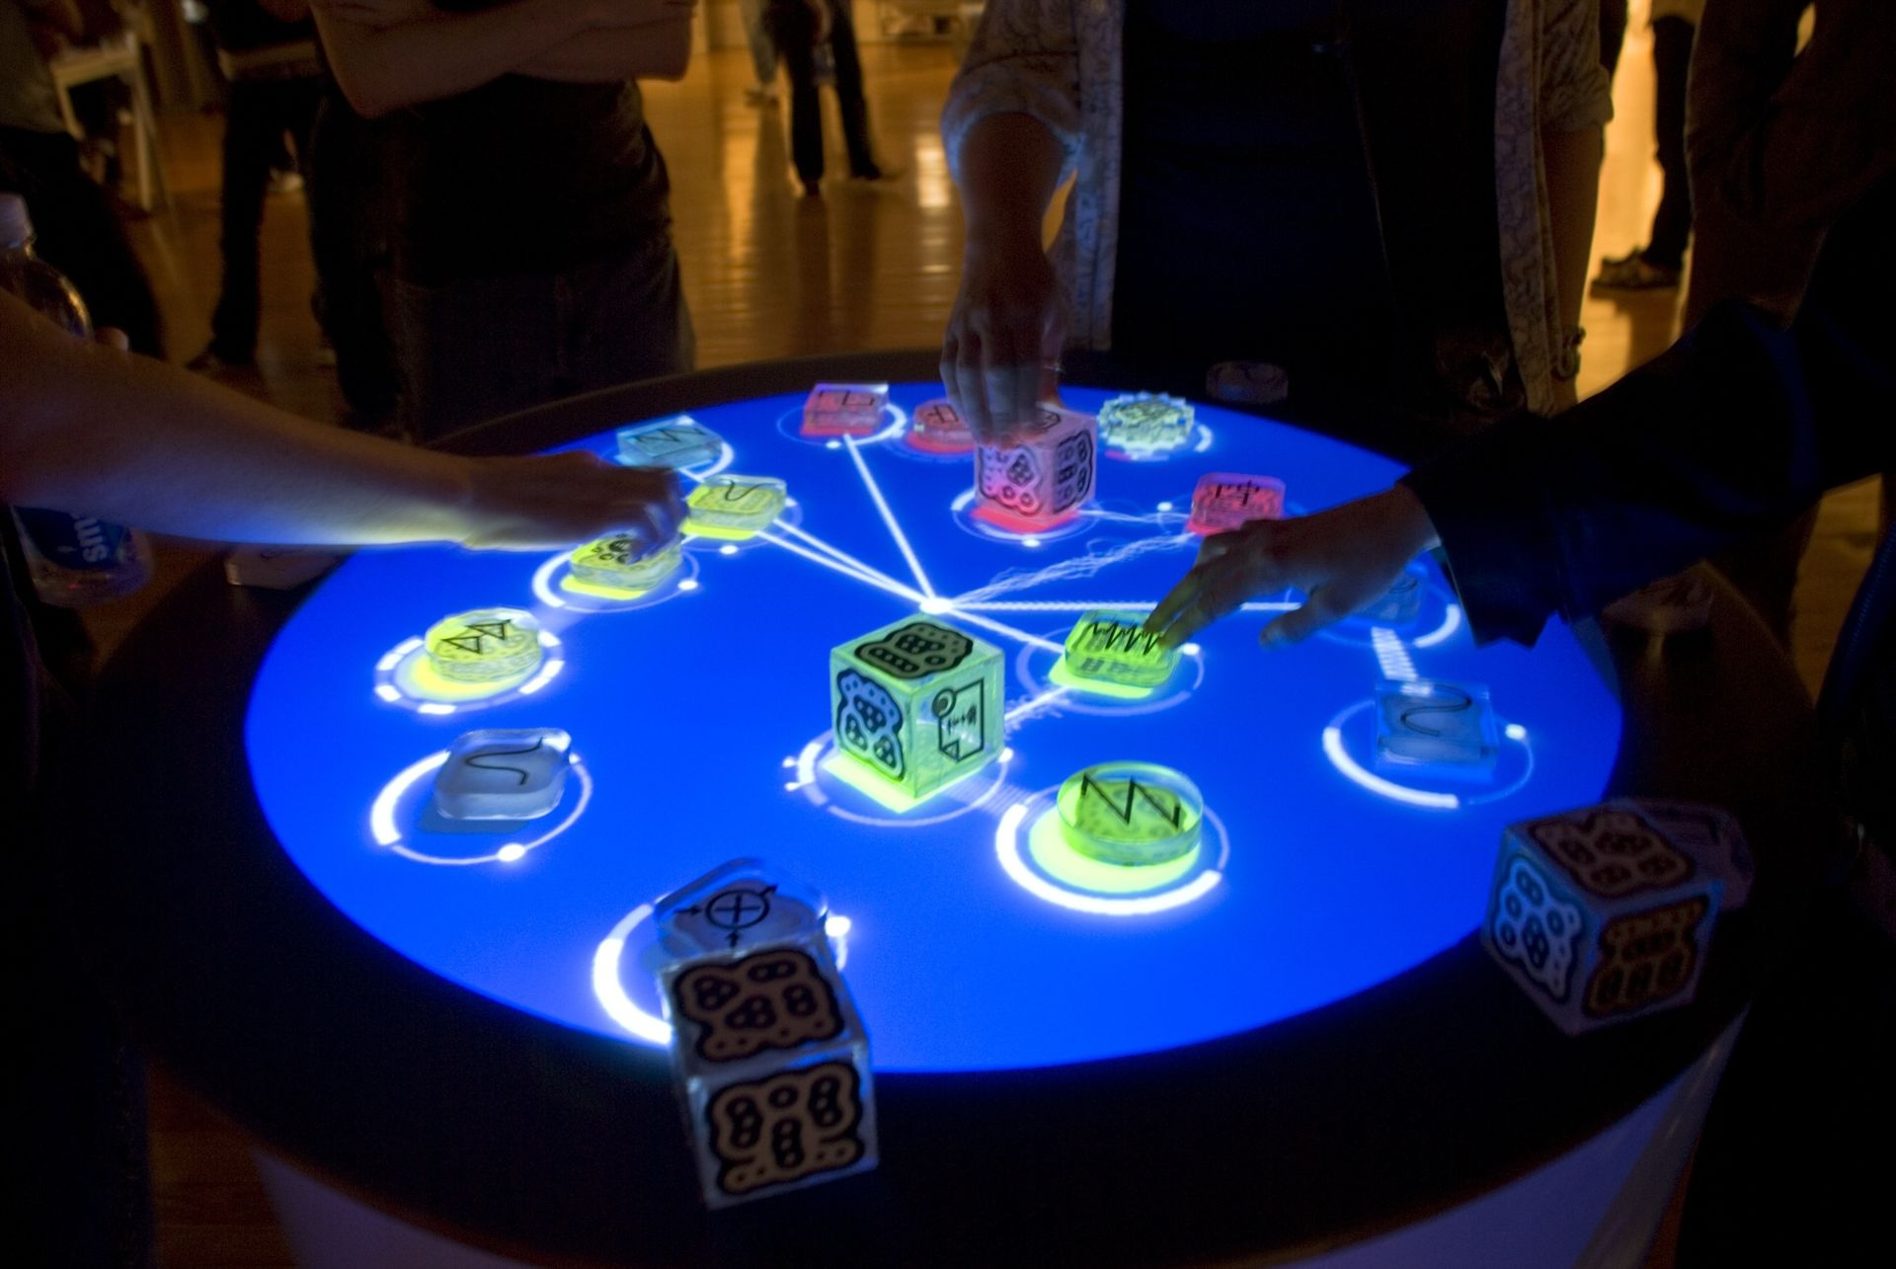
Introduction
Textbook
Designing the User Interface: Strategies for Effective Human-Computer Interaction. Ben Shneiderman et al. 2018
Assessment
1 assignment
1 exam
Details and instructions will be available on the AEMG Cloud Classroom site
This Photo by Unknown Author is licensed under CC BY-SA

Slide 5
Topics
2

Slide 6
Topics
Understanding Users
The Design Process
Interaction Design
Interface Design
Evaluating Interfaces

Slide 7

Understanding Users
Good designers have the ability to understand the intended users of a product. They under-stand what it is that users want — not just what they say they want; and can identify the real needs of their clients.
Source: interactive.usc.edu

Slide 8
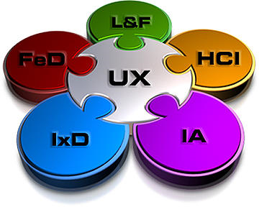
The Design Process
How should we design?
Why the focus on ‘users’ and the ‘user experience’?
What steps are used to design interfaces?
Source: meteortree.com

Slide 9
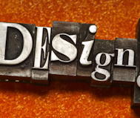
Interaction Design
Good design is not only about making something look good: it is more importantly about making the product usable.
How can the ‘conversations’ between users and systems occur with ease.
Source: www.synology.com

Slide 10
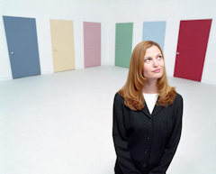
Interface Design
This topic defines what we mean by ‘looking good’.
To look ‘good’ an interface needs to adopt the principles of good graphic design and exhibit harmony, balance, and simplicity.
Source: www.decorateyourspace.net

Slide 11

Evaluating Interfaces
Good designers will evaluate their work constantly. Two primary methods are used to accomplish this: a heuristic evaluation or a user evaluation.
Source: blogs.msdn.com

Slide 12
USER CENTRED DESIGN
3

Slide 13
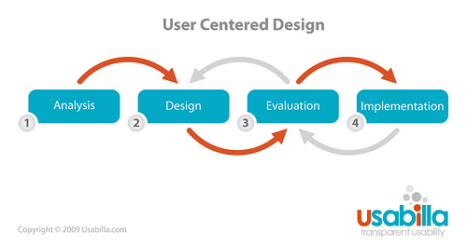
User Centred Design Overview
These topics lead our investigation into User Centred Design
UCD requires designers and developers to understand the problem, the users, prototype and work on solutions, and evaluate
This is an iterative process.
Source: https://www.flickr.com/photos/pveugen/3199345360

